Slide 1

P-454
BOOK RECOMMENDATION
SYSTEM
Group members:
CHETAN SHAMRAO KOPARE
NAMITHA KUMARI
PRANJAL SHOBHNATH YADAV
SURENDRA KUMAR ABALUR

Slide 2

PAGE :
CONTENTS
Dataset Description
Exploratory Data Analysis (EDA)
Visualization
Model Building
Conclusion
Deployment

Slide 3

ABOUT
DATASET DESCRIPTION
A book recommendation system dataset includes information about Books (titles, authors, genres, ratings), Users (IDs, demographics), and their Interactions (reviews, purchase history). This data is being used to predict books a user might enjoy by analyzing preferences, past behaviors, and similarities with other users.

Slide 4
MODLING DATA
DATA PROCESSING:
DATASET INVOLVED:
Ratings_df: Contains user ratings for Books.
Books_df : Contains metadata like Book-Title, Author, Publisher, etc.
Users_df : Contains users information.
2. MERGING DATASETS: user and ratings with user id (merged with books on isbn)
The User dataset and Ratings dataset are first merged on “USER ID” and stored under a variable name “merged_df”
Then, the “merged_df” was further merged with Books dataset on “ISBN”

Slide 5
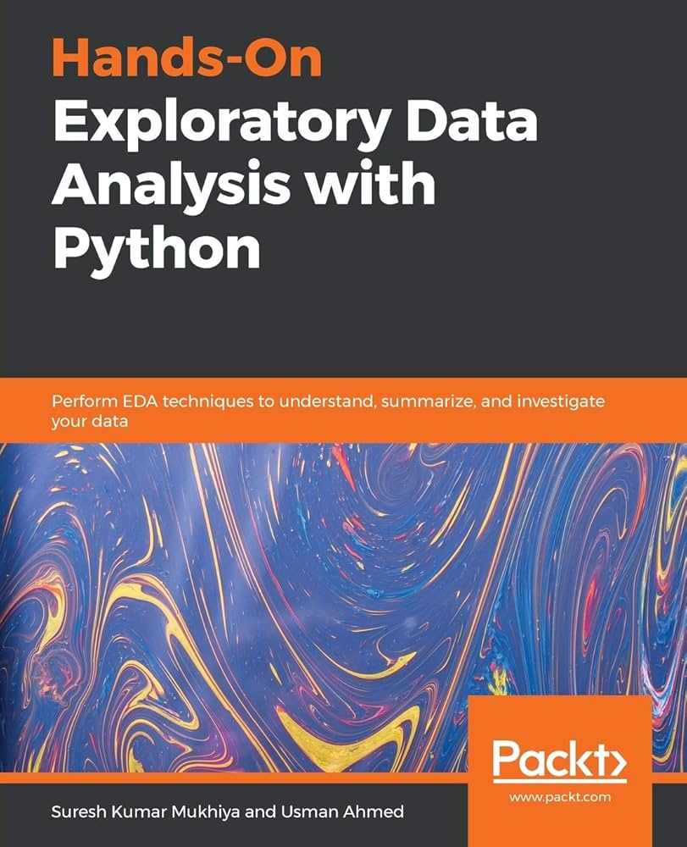
ABOUT
EDA
Understanding from EDA :
Distribution of Ratings: Understand if ratings are balanced or skewed.
Top Books: Identify the most highly-rated books.
Active Users: Find users who provide the most ratings.
Trends Over Time: See how the number of ratings changes over the year

Slide 6
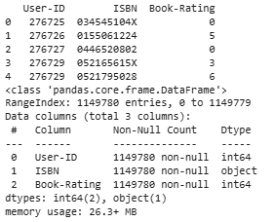
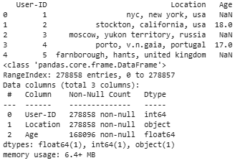
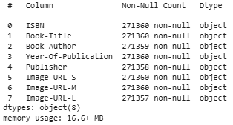
RATINGS
ROWS:1324564
COLUNMS:12
USERS
ROWS:241071
COLUNMS:8
BOOKS
ROWS:24101
COLUNMS:3

Slide 7
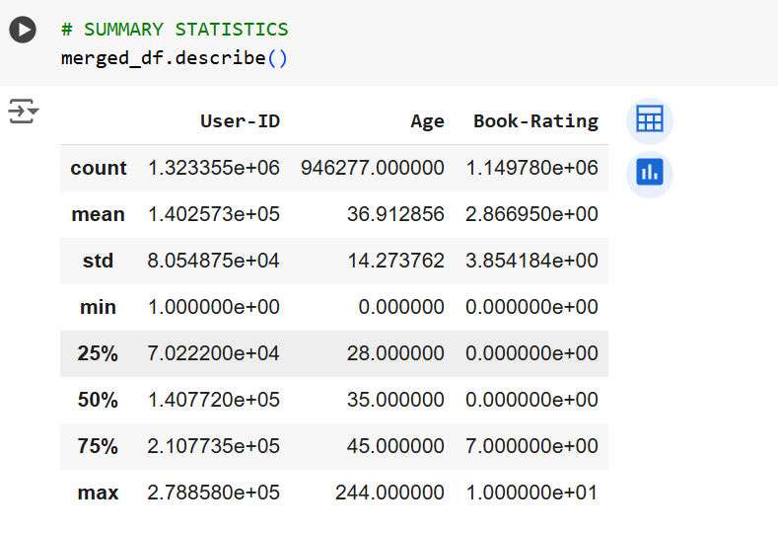
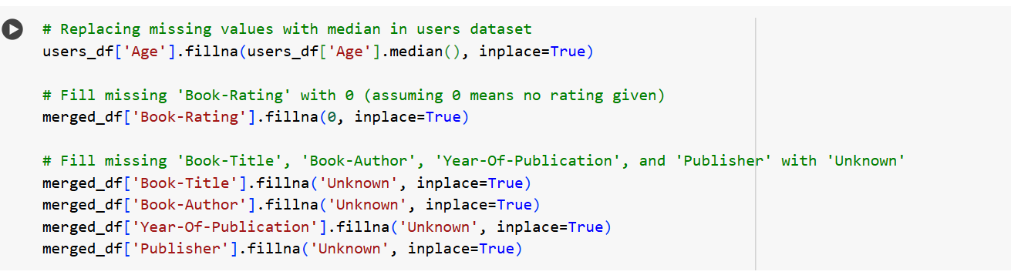
FURTHER BASIC EXPLORATION

Slide 8
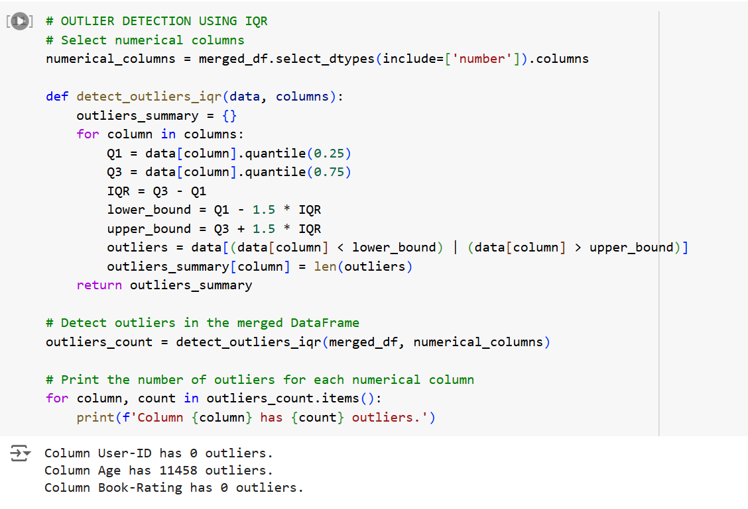
OUTLIERS

Slide 9
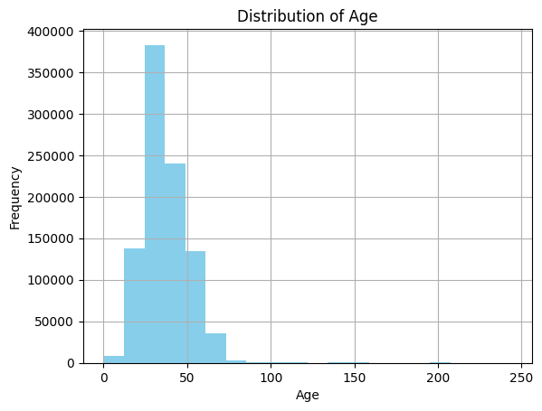
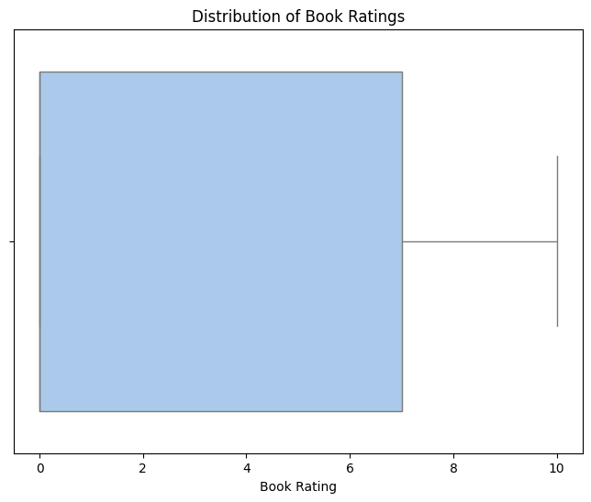
VISUALIZATIONS
OUTLIER
AGE DISTRIBUTION
The age distribution plot provides insights into the demographics of the user base, which can be valuable for targeted marketing and feature development.

Slide 10
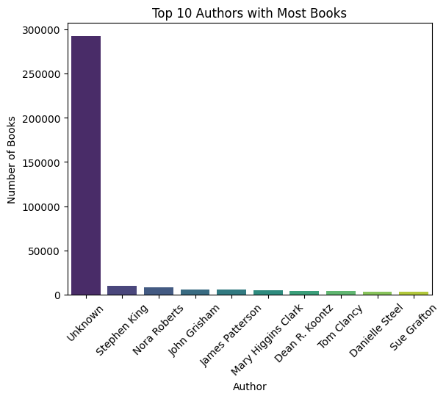
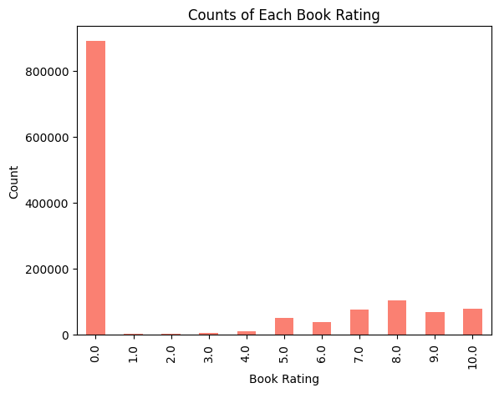
BAR CHART DISTRIBUTION
Top 10 Authors by Ratings
The chart highlights the top 10 authors with the highest average book ratings, indicating their popularity and critical acclaim among readers.
Books Ratings Distribution
This chart shows the distribution of book ratings, providing insights into the overall quality and popularity of the books in the dataset.

Slide 11
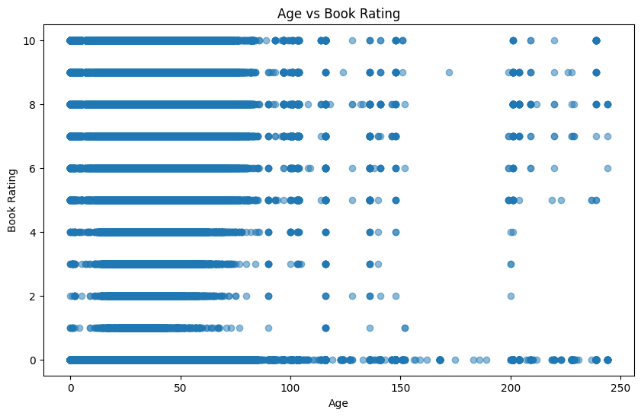
SCATTER PLOT
AGE VS BOOK-RATING
Insights from the Scatter Plot:
Positive Correlation: Books with more ratings may show a stable average rating, as large numbers of ratings reduce the effect of extreme values (very high or low ratings).
Outliers: Books with a low number of ratings but a high average rating, or a high number of ratings with a low average rating, might be outliers that could merit further investigation.
Trends: If there is a visible trend, such as books with more ratings having a higher average rating, it can inform how the system may prioritize books based on popularity.

Slide 12
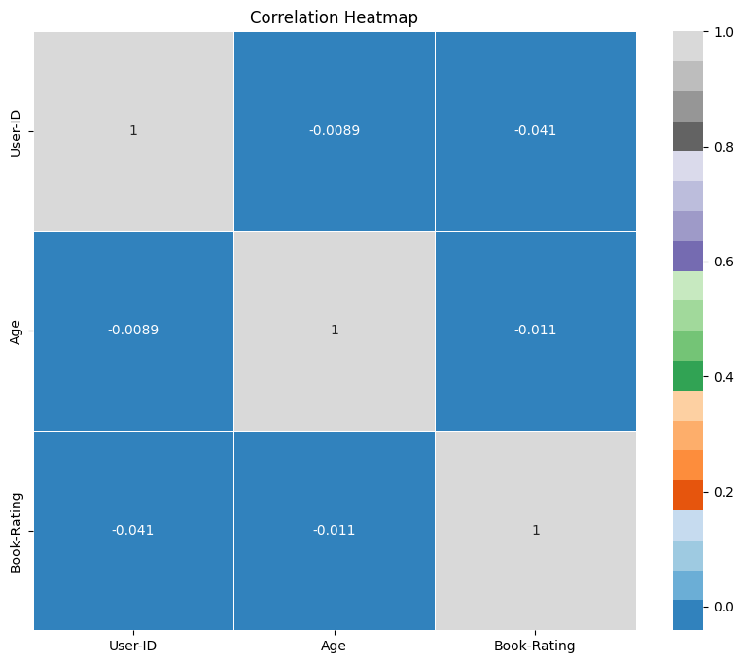
HEATMAP
CORRELATION HEATMAP
Explanation:
Ratings Matrix: The data is first transformed into a user-item matrix (with users as rows and books as columns), where the values represent the ratings given by users.
Correlation Matrix: This is computed to capture how similar different books are in terms of ratings. Books with similar ratings across users will have a higher correlation.
Heatmap: The sns.heatmap function plots the correlation matrix, where the color intensity indicates the degree of correlation (from blue for negative correlation to red for positive correlation)

Slide 13
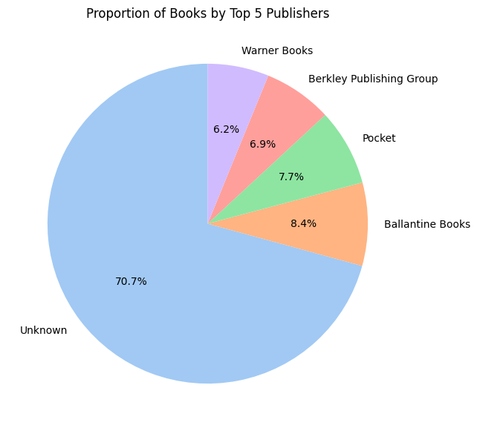
PIE CHART
PROPORTION OF BOOKS BY TOP 5 PUBLISHERS
Conclusion:
Pie charts are ideal for visualizing proportional data and can help easily understand the distribution of ratings or genres in a book recommendation system. These visualizations give quick insights into user behavior or book characteristics, which can be used to refine recommendations or detect biases in the data.

Slide 14
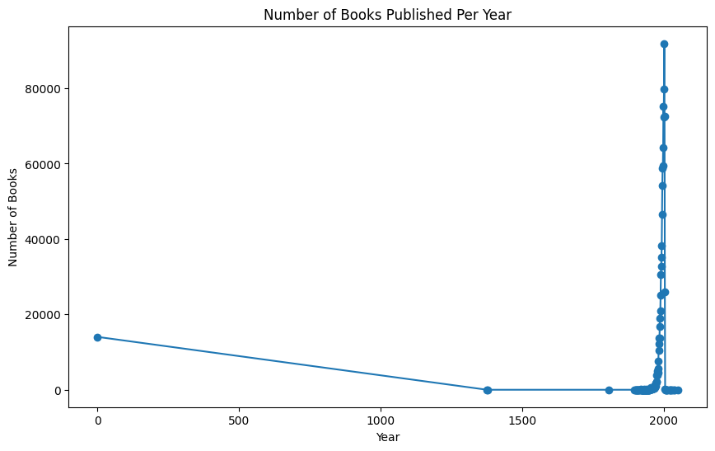
LINE PLOT
NUMBER OF BOOKS PUBLISHED PER YEAR
Conclusion:
A line plot is a great tool for analyzing trends and changes over time in a book recommendation system. It can help you understand how user feedback evolves, identify patterns, and track the popularity of books or the overall system. This insight can guide adjustments to recommendation algorithms or help marketers plan strategies around trending books.

Slide 15
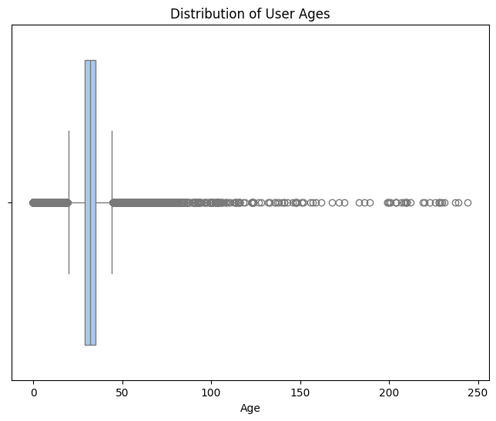
BOXPLOTS :
DISTRIBUTION OF USER AGES
Conclusion:
A box plot is an excellent way to visualize the distribution of book ratings. It allows you to easily identify the range of ratings, any potential outliers, and the central tendency for each book or genre. In a book recommendation system, this can help you understand user sentiment and adjust recommendations to favor books with a balanced distribution of ratings or highlight those that are more polarizing.

Slide 16
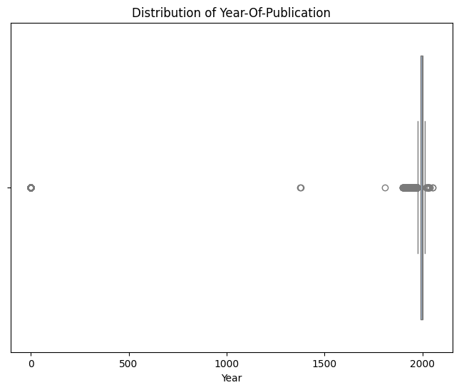
DISTRIBUTION OF YEAR-OF-PUBLICATION
Conclusion from the Box Plot of Year of Publication:
Recent Trends: Newer books may show higher median ratings, indicating better reception, while older books may have more variability in ratings.
Outliers: Significant outliers can point to exceptionally popular or poorly received books in specific years.
Publication Patterns: A higher concentration of books in certain years could reflect increased publication activity, possibly due to industry changesdiverse opinions.

Slide 17

ABOUT
MODEL BUILDING
Conclusion:
This popularity-based approach allows users to discover books that have already been well-rated by many users, making it an effective, simple recommendation strategy.
The system’s recommendation power is based solely on the number of ratings and average rating, making it suitable for new users who do not have personalized preferences yet.

Slide 18
RECOMMENDER MODELS :
1. Popularity Based Recommendation System
2. Collaborative filtering based recommendation system
CONCLUSION:
Both the models are able to predict accurately. The most accurate and easy recommender model with which we could move ahead for deployment using Streamlit was “Collaborative Filtering Based Recommender System”

Slide 19
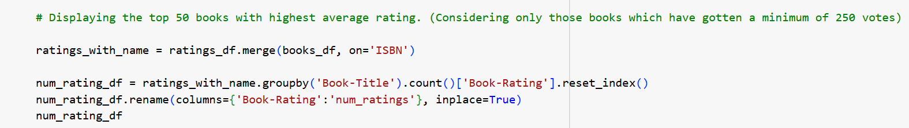
1. POPULARITY BASED RECOMMENDATION SYSTEM
INPUT:

Slide 20
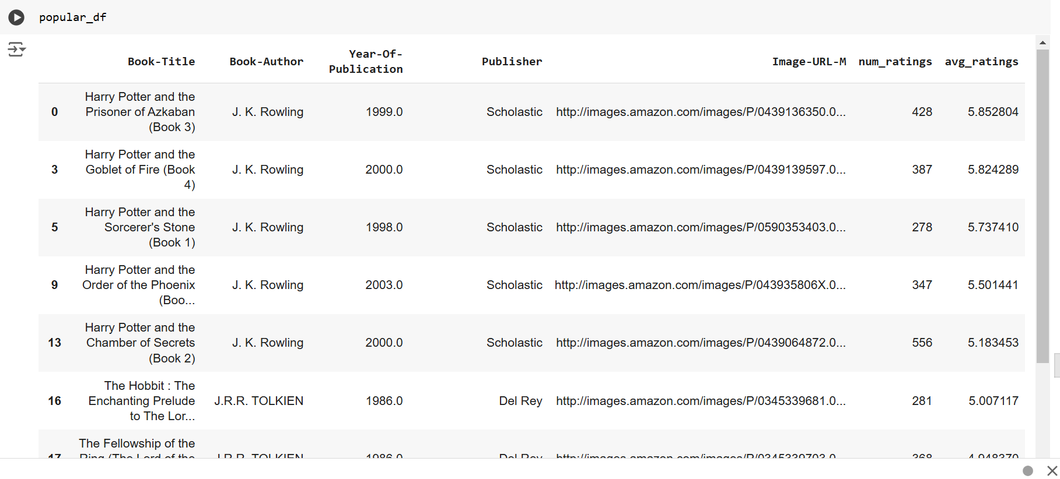
OUTPUT:

Slide 21
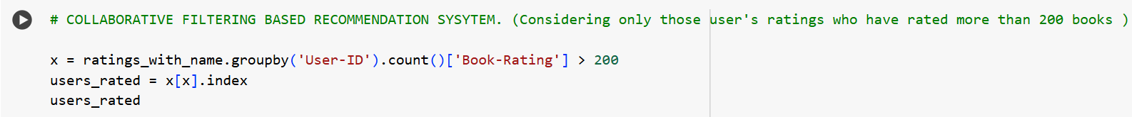
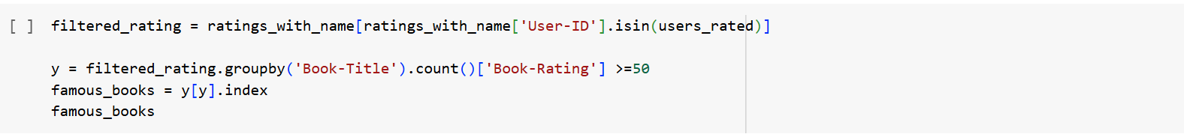
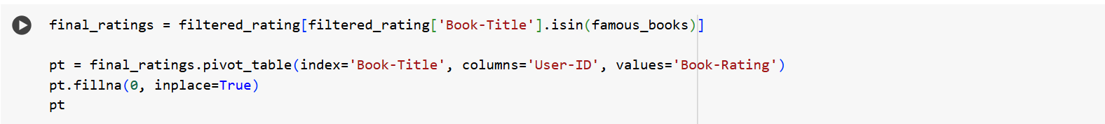
2. COLLABORATIVE FILTERING BASED RECOMMENDATION SYSTEM
INPUT:

Slide 22
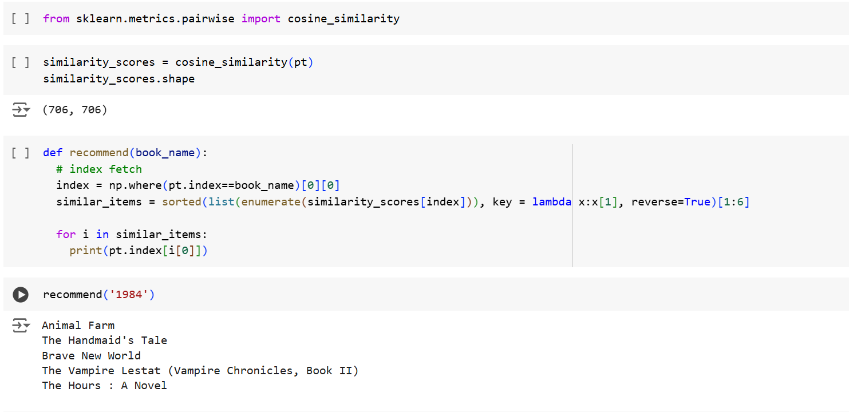
OUTPUT:

Slide 23
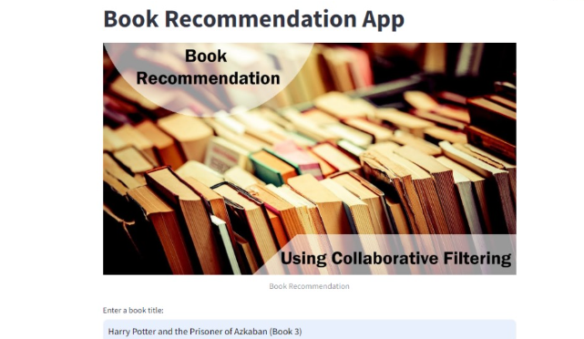
DEPLOYMENT
In the deployment phase, the collaborative filtering-based book recommendation system can be integrated into a web or application interface where users can receive highly personalized recommendations based on their preferences and similarities with other users. The system’s ability to leverage user-item interaction data ensures tailored suggestions that resonate with individual tastes. Users will benefit from discovering books that align closely with their interests, while the backend can be continuously updated with new user interactions and feedback to refine the recommendation model and maintain relevance.

Slide 24
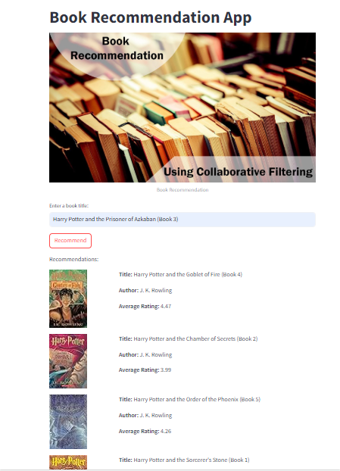
Deploying the Book Recommendation System Using Streamlit App
The book recommendation system is deployed as an interactive Streamlit app, providing a seamless user experience for discovering books. With its lightweight and intuitive interface, Streamlit makes it easy to integrate collaborative filtering algorithms, display book details, and provide personalized recommendations. Users can input their favorite book titles and instantly receive suggestions, complete with images, authors, and ratings, in a well-organized format. This deployment approach ensures accessibility, scalability, and real-time interaction, making it ideal for showcasing recommendation systems to a broad audience.

Slide 25
Key challenges in project
Data Issues: Incomplete, sparse, or inconsistent data.
Cold Start Problem: Difficulty recommending for new users or books.
Scalability: Managing large datasets efficiently.
Popularity Bias: Over-promoting popular books while neglecting niche titles.
Dynamic Preferences: Adapting to users' evolving tastes.
Ethical Concerns: Avoiding biased recommendations and ensuring diversity.

Slide 26
CONCLUSION
Both the models are able to predict accurately. The most accurate and easy recommender model with which we could move ahead for deployment using Streamlit was “Collaborative Filtering Based Recommender System”

Slide 27
THANK YOU!

